Slide 1
Building blocks

Slide 2
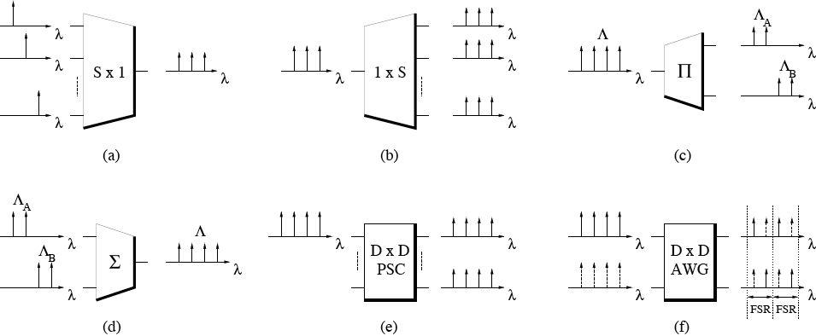
Building blocks
Components

Slide 3
Building blocks
Components
  (a) Combiner
    Collects different wavelength channels from S input ports & combines them onto common output port
  (b) Splitter
    Equally distributes all wavelength channels arriving on input port to S output ports
  (c) Waveband partitioner
    Partitions set of wavelength channels incoming on input port into two different wavebands & routes each of them to separate output port
  (d) Waveband departitioner
    Collects two different wavebands incoming on separate input ports & combines them onto common output port

Slide 4
Building blocks
Components
  (e) Passive star coupler (PSC)
    Static wavelength-broadcasting device
    Works like a combiner and a splitter interconnected in series
    Collects different wavelength channels from all input ports & equally distributes them to all output ports
  (f) Arrayed waveguide grating (AWG)
    Static wavelength-routing device with periodic wavelength response called free spectral range (FSR)
    Physical degree of AWG = number of wavelength channels per FSR, one to reach each AWG output port
    Each FSR provides one wavelength channel for each AWG input-output port pair
    AWG allows for spatial reuse of all wavelength channels at all input ports <=> PSC

Slide 5
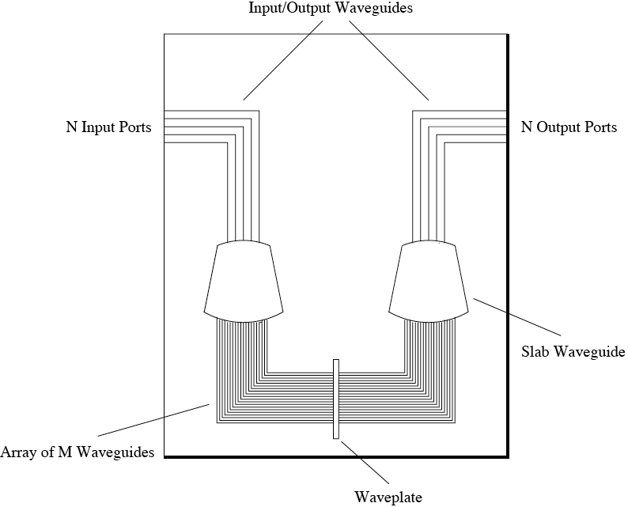
Building blocks
AWG
  Aka phased array (PHASAR) or waveguide grating router (WGR)
  Consists of
    N input & N output waveguides
    Two slab waveguides (free propagation regions)
    Array of M>>N waveguides whose length differ by constant value
    Waveplate at symmetry line of device for polar-ization independence

Slide 6
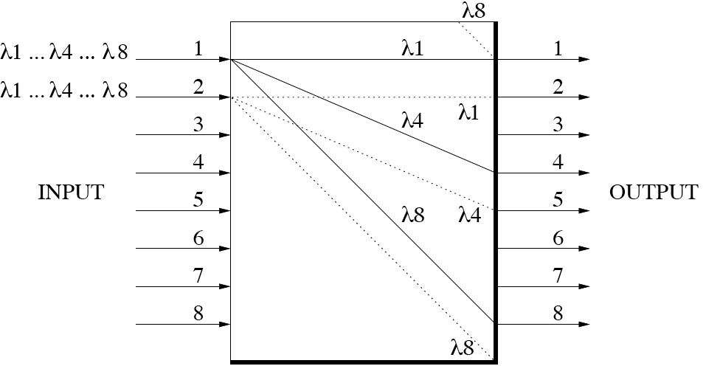
Building blocks
AWG
  Array of waveguides introduces wavelength-dependent phase delays such that only frequencies with phase difference of integer times 2π interfere constructively in output slab waveguide => each output port carries periodic pass frequencies
  Spacing of pass frequencies is called free spectral range (FSR)

Slide 7
Building blocks
Transmitters
  A transmitter consists of light source, modulator, and supporting electronics
  Two major types of light sources
    Broadband light sources
      Light output has broad spectrum of 10-100 nm, e.g., low-cost light-emitting diode (LED)
      LED offers small bandwidth-distance product => low data rate and/or short distance applications
    Lasers
      A laser is optical amplifier enclosed within reflective cavity that causes light to oscillate via positive feedback
      Lasers achieve significantly larger bandwidth-distance product than LED

Slide 8
Building blocks
Lasers
  Lasers can be categorized into
    Lasers fixed tuned to nominal wavelength
    Continuously or discretely tunable lasers by controlling cavity length and/or reflective index of lasing medium
  Examples
    Fabry-Perot, distributed feedback (DFB), or distributed Bragg reflector (DBR) lasers
Transmitter type | Tuning range | Tuning time
Mechanically tunable | 500 nm | 1-10 ms
Acousto-optic | ≈ 100 nm | ≈ 10 µs
Electro-optic | 10-15 nm | 1-10 ns
Injection current | ≈ 30 nm | 15 ns

Slide 9
Building blocks
Receivers
  A receiver consists of optical filter, photodetector, demodulator, and supporting electronics
    Optical filter used to select slice of broadband signal or wavelength of WDM comb
    Photodetector optoelectrically converts selected slice/wavelength

Slide 10
Building blocks
Optical filters
  Optical filters can be categorized into
    Filters fixed tuned to nominal wavelength
    Continuously or discretely tunable filters
  Examples
    Mach-Zehnder interferometer (MZI), diffraction grating, dielectric thin-film, or fiber Bragg grating (FBG) filters
Receiver type | Tuning range | Tuning time
Mechanically tunable | 500 nm | 1-10 ms
Thermally tunable | > 10 nm | 1-10 ms
Acousto-optic | ≈ 100 nm | ≈ 10 µs
Electro-optic | 10-15 nm | 1-10 ns
Liquid crystal | 30-40 nm | 0.5-10 µs

Slide 11
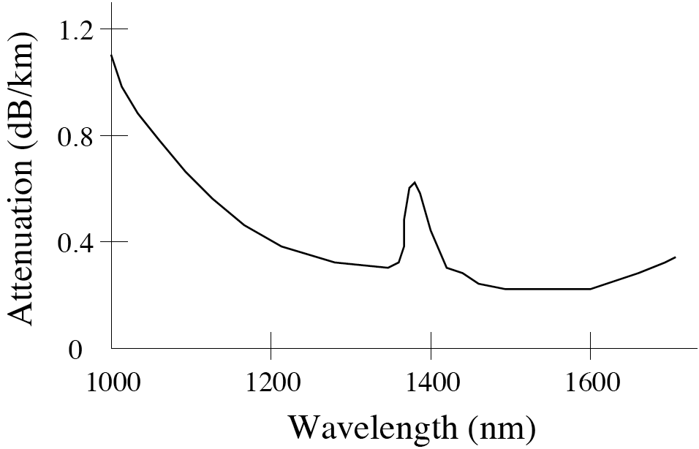
Building blocks
Transmission impairments
  Attenuation
    Optical signal power reduced by
      Components
      Fiber
    Attenuation of fiber is a function of wavelength
    Peak loss in 1400-nm region due to hydroxyl ion (OH¯) impurities <=> Lucent AllWave fiber
    Three wavelength bands at 0.85, 1.3, and 1.55 µm are widely used in today’s optical communications systems

Slide 12
Building blocks
Transmission impairments
  Dispersion
    Dispersion denotes the effect wherein different components of the transmitted optical signal travel at different velocities in the fiber, arriving at different times at the receiver
    As a result, pulse widens & causes intersymbol interference (ISI)
    Dispersion limits minimum bit spacing (i.e., maximum transmission rate)
    Amount of accumulated dispersion depends on length of fiber link

Slide 13
Building blocks
Transmission impairments
  Dispersion
    Important forms
      Modal dispersion
      Waveguide dispersion
      Chromatic (material) dispersion
      Polarization mode dispersion

Slide 14
Building blocks
Transmission impairments
  Modal dispersion
    Arises only in multimode fiber where different modes travel at different velocities
    Does not occur in single-mode fiber (SMF)
  Waveguide dispersion
    Transmitted optical light pulse distributed between fiber core & cladding
    Waveguide dispersion caused because both portions propagate at different velocities since fiber core & cladding have different refractive indices

Slide 15
Building blocks
Transmission impairments
  Chromatic (material) dispersion
    Arises because different frequency components of transmitted optical light pulse travel at different velocities due to the fact that refractive index of fiber is a function of wavelength
    Typically measured in units of ps/(nm·km) (e.g., 17 ps/(nm·km) for standard SMF at 1550 nm)
    Waveguide dispersion can be controlled to realize nonzero dispersion shifted fibers (NZ-DSFs)
      Alcatel TeraLight metro fiber with 8 ps/(nm·km) => 10 Gb/s operation over 80-200 km without requiring costly/complex dispersion compensation

Slide 16
Building blocks
Transmission impairments
  Polarization mode dispersion (PMD)
    Arises because fiber core is not perfectly circular, particularly in older installations
    Different polarizations of optical signal travel at different velocities
    Serious impediment in very-high-speed systems operating at 10 Gb/s & beyond

Slide 17
Building blocks
Transmission impairments
  Nonlinearities
    Fiber nonlinearities take place when optical power levels get fairly high
    Can place significant limitations on high-speed & WDM systems
    Can be classified into two categories
      Effects owing to dependence of refractive index on optical power
        Self-phase modulation (SPM)
        Cross-phase modulation (XPM)
        Four-wave mixing (FWM)
      Effects owing to interaction of light waves with phonons (molecular vibrations) in fiber
        Stimulated Raman scattering (SRS)
        Stimulated Brillouin scattering (SBS)

Slide 18
Building blocks
Transmission impairments
  Self-phase modulation (SPM)
    Variations in optical signal power results in variations in phase of signal & variations of frequency around signal’s central frequency
    Additional frequency components generated by SPM combined with effects of material dispersion lead to spreading or compression of pulse in time domain, affecting maximum bit rate & bit error rate (BER)
  Cross-phase modulation (XPM)
    Shift in phase of signal caused by change in intensity of a signal propagating at different wavelength
    XPM can lead to asymmetric spectral broadening
    Combined with SPM & dispersion, XPM may affect pulse shape in time domain

Slide 19
Building blocks
Transmission impairments
  Four-wave mixing (FWM)
    Occurs when two wavelengths, operating at frequencies f₁ and f₂ , mix to cause signals at frequencies such as 2f₁ - f₂ and 2f₂ - f₁
    Extra signals can cause interference if they overlap with frequencies used for data transmission
    Similarly, mixing can occur between combinations of three & more wavelengths

Slide 20
Building blocks
Transmission impairments
  Stimulated Raman scattering (SRS)
    Caused by interaction of light with molecular vibrations
    Portion of light traveling at each frequency is downshifted across region of lower frequencies => Stokes wave
    Fraction of power transferred to Stokes wave grows rapidly with increasing power of input signal
    In WDM systems, shorter-wavelength channels lose some power to longer-wavelength channels
    To reduce loss, power on each channel needs to be below certain level

Slide 21
Building blocks
Transmission impairments
  Stimulated Brillouin scattering (SBS)
    Frequency shift caused by sound waves (rather than molecular vibrations)
    Stokes wave propagates in opposite direction of input light
    Intensity of scattered light much greater in SBS than in SRS, but frequency range much lower in SBS than in SRS
    In WDM systems, SBS induces crosstalk between channels when two counterpropagating channels differ in frequency by Brillouin shift (≈ 11 GHz @ 1550 nm)
    To counter effects of SBS, input power must below certain threshold

Slide 22
Building blocks
Transmission impairments
  Crosstalk
    Decreases signal-to-noise ratio (SNR) => increased BER
    Two types of crosstalk
      Interchannel crosstalk
        Caused by signals on different wavelengths
        Must be considered for channel spacing
        May be removed by using narrowband filters
      Intrachannel crosstalk
        Caused by signals on same wavelength on other fiber(s) due to imperfect transmission character-istics of components
        Usually occurs in multiport switching/routing nodes
        Cannot be removed through filtering

Slide 23
Building blocks
Transmission impairments
  Noise
    SNR deteriorated by different noise terms
      Amplified spontaneous emission (ASE)
        Besides stimulated emission, spontaneous emission takes place in Erbium doped fiber amplifier (EDFA)
        EDFA amplifies spontaneous emission in addition to incident light signal => ASE
      Shot noise
        Photodetector converts optical signal into electrical photocurrent & additional shot noise current
        Shot noise current occurs due to random distribution of electrons generated by photodetection process
      Thermal noise
        Electrical amplifier introduces additional thermal noise current due to random motion of electrons

